Slide 1
We are learning about chemical reactions
TRACK WITH ME
READ WITH ME
Students will be able to:
Identify reactants and products in chemical reactions
Write word equations for chemical reactions

Slide 2
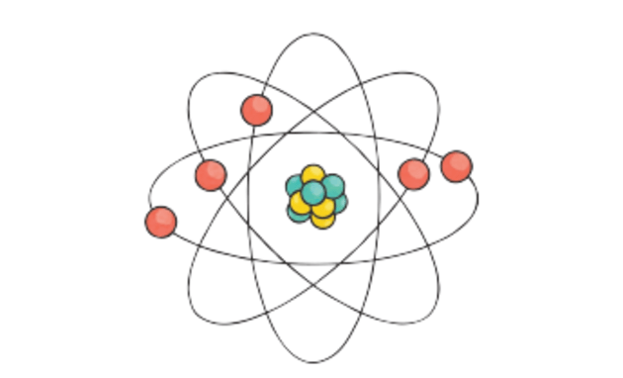
Repeat the opposite word/phrase.
ATOM
THE SMALLEST PARTICLE OF A CHEMICAL ELEMENT THAT CAN EXIST.

Slide 3
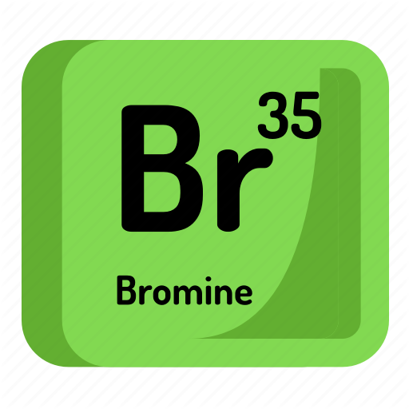
Repeat the opposite word/phrase.
ELEMENT
A SUBSTANCE THAT CONTAINS ONLY ONE TYPE OF ATOM

Slide 4
Common chemical reactions
When sodium bicarbonate is added to a solution of citric acid we see bubbling.
This is because a new chemical carbon dioxide gas, is produced.
During this reaction water and sodium citrate are also produced.
If we measured the temperature we would find that it goes down as the reaction continues. This is a change in the heat energy.
In this reaction two chemicals join together to form a new set of chemicals.

Slide 5
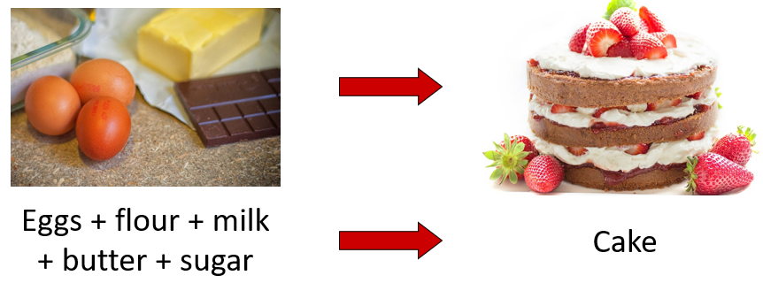
Common chemical reactions
Everyday chemical reactions include milk going off and cooking a cake.
Things such as water boiling or freezing are not chemical reactions as no new chemicals are produced.

Slide 6
Questions
What are the starting chemicals and chemicals made in the example above?
Give examples of the everyday chemical reactions in the text and think of two others.

Slide 7
Signs of a chemical reaction
Think, pair, share
What are the signs of a chemical reaction?

Slide 8
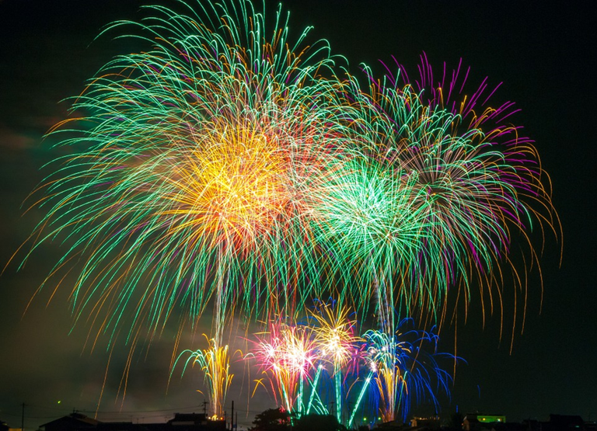
Signs of a chemical reaction
Think, pair, share
What are the signs of a chemical reaction?
There may be a change in colour

Slide 9
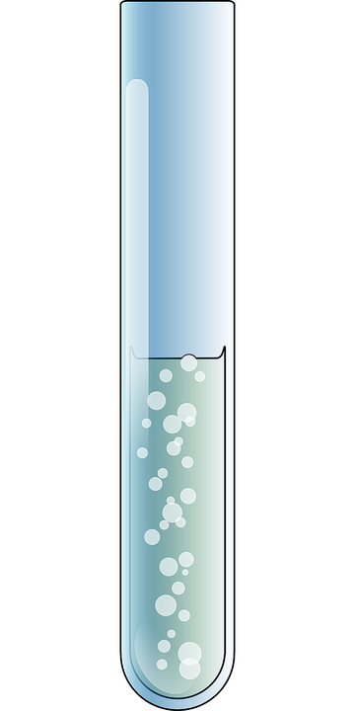
Signs of a chemical reaction
Think, pair, share
What are the signs of a chemical reaction?
There may be a gas given off (bubbles)

Slide 10
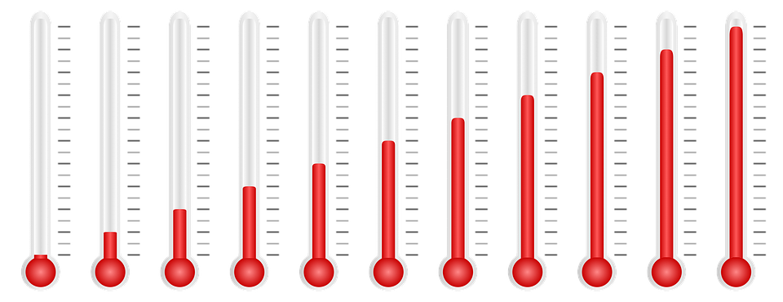
Signs of a chemical reaction
Think, pair, share
What are the signs of a chemical reaction?
There may be an energy change - the chemical(s) give out or take in heat energy, getting hotter or colder

Slide 11
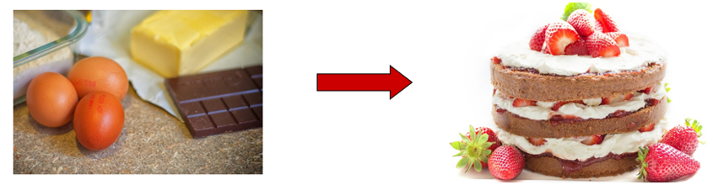
Signs of a chemical reaction
Think, pair, share
What are the signs of a chemical reaction?
New chemicals are formed, and
the change is usually difficult to reverse

Slide 12
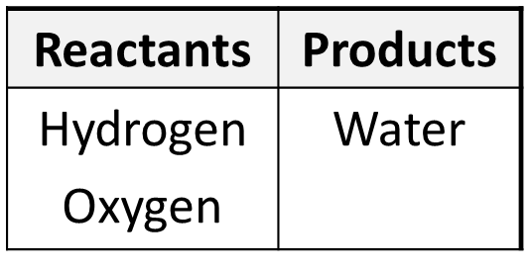
Reactants and Products
In a chemical reaction we start with one set of chemicals called the reactants.
A reaction happens and we end up with another set, called the products.
Look at the worksheet and for each question write the reactants and products in a table.
Example: when hydrogen and oxygen are reacted together they form water

Slide 13
Word Equations
To show what is happening during a chemical reaction we can write a word equation
Reactants go on the left side, products on the right.

Slide 14
Word Equations
We use an arrow not an equals sign (=).
The arrow means “reacts to form”

Slide 15
Question 1 – Let’s do this together
When methane is burned in oxygen it produces a gas, carbon dioxide and water.
a. What are the reactants?
methane and oxygen
b. What the products?
carbon dioxide and water
c. What is the word equation?
methane + oxygen → carbon dioxide + water

Slide 16
Question 2 – Your turn
Lead nitrate reacts with potassium iodide. This produces a yellow solid called lead iodide and a clear liquid called potassium nitrate.
a. What are the reactants?
lead nitrate and potassium iodide
b. What the products?
lead iodide and potassium nitrate
c. What is the word equation?
lead nitrate + potassium iodide → lead iodide + potassium nitrate

Slide 17
Question 3 – Your turn
In a car, when the engine is started enough energy is produced to combine nitrogen from the air with oxygen to form nitrogen dioxide.
a. What are the reactants?
nitrogen and oxygen
b. What the products?
nitrogen dioxide
c. What is the word equation?
nitrogen + oxygen → nitrogen dioxide

Slide 18
Question 4 – Your turn
To make sodium chloride one possible method is to react hydrochloric acid and sodium hydroxide together. This reaction also produces water.
a. What are the reactants?
hydrochloric acid and sodium hydroxide
b. What the products?
sodium chloride and water
c. What is the word equation?
hydrochloric acid + sodium hydroxide → sodium chloride + water

Slide 19
Question 5 – Your Turn
Often during an experiment, we find that a gas is produced. An example of this is the production of hydrogen when a metal, such as magnesium, reacts with an acid, such as hydrochloric acid. In this reaction magnesium chloride and hydrogen will be produced.
a. What are the reactants?
magnesium and hydrochloric acid
b. What the products?
magnesium chloride and hydrogen gas
c. What is the word equation?
magnesium + hydrochloric acid → magnesium chloride + hydrogen gas

Slide 20
Question 6 – Your turn
The colour of fireworks comes from the reactions of different metals with oxygen. The production of magnesium oxide gives a bright white colour. This comes from the reaction between magnesium and oxygen. Heat energy is needed for this to happen.
a. What are the reactants?
magnesium and oxygen
b. What the products?
magnesium oxide
c. What is the word equation?
magnesium + oxygen → magnesium oxide

Slide 21
We are learning about chemical reactions
TRACK WITH ME
READ WITH ME
Students will be able to:
Identify reactants and products in chemical reactions
Write word equations for chemical reactions
Summarise what you learnt today at the bottom of your worksheet

